Slide 1
Maze Generation Algorithms
Vivienne Zhu Pace University CS 242 Algorithms & Computing Theory

Slide 2
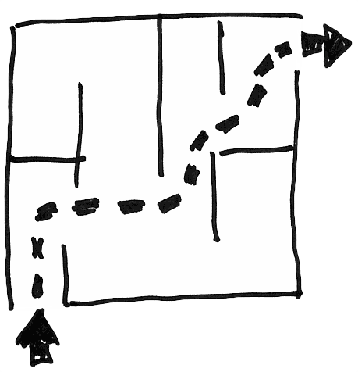
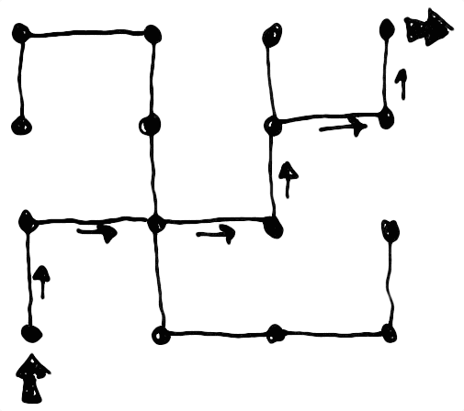
Maze
Everyone is familiar with mazes, they are puzzles where we have to draw a line from a starting point to an end point without crossing any walls. But they are also embodiment of graph theory such as nodes and edges, shortest paths, spanning trees, etc.

Slide 3
Perfect Maze
A "perfect" Maze is also called a simply-connected Maze. There is exactly one path from each point to any other point.
The Maze has exactly one solution that does not involve retracing steps.
In Computer Science terms, such a Maze can be described as a spanning tree over the set of cells or vertices.

Slide 4
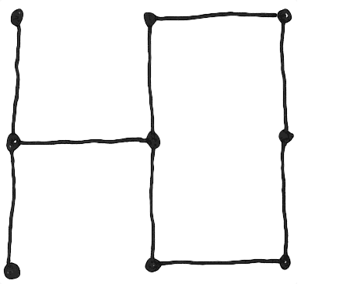
Review
A graph is a collection of vertices and the edges that connect them. When you can reach any vertex in the graph from other vertex by following edges, then this graph is connected, which means it has a cycle, or a loop.
vertex
edge

Slide 5
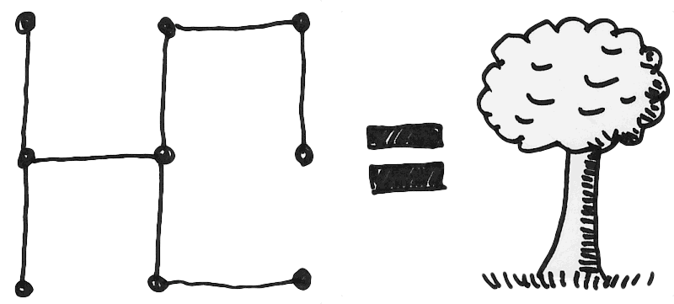
Continue…
If you remove the cycle, you get an acyclic graph. And this connected, acyclic graph is called a tree.

Slide 6
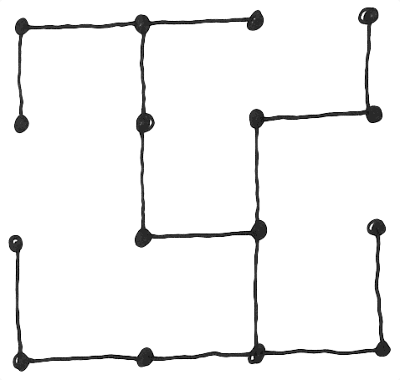
CONTINUE…
A spanning tree is when a tree comprises all the vertices in a graph.
Kruskal’s algorithm is a method for producing a minimal spanning tree from a weighted graph.

Slide 7
Kruskal's algorithm (Original Version)
Throw all of the edges in the graph into a set.
Pull out the edge with the lowest weight. If the edge connects two disjoint trees, join the trees. Otherwise, throw that edge away.
Repeat until there are no more edges left.

Slide 8
Kruskal's algorithm (randomized version)
Throw all of the edges in the graph into a set.
Remove an edge from the set at random. If the edge connects two disjoint trees, join the trees. Otherwise, throw that edge away.
Repeat until there are no more edges left.

Slide 9
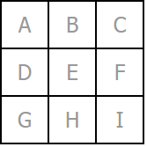
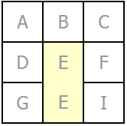
Example
Use a simple 3×3 grid. Assign each cell a letter, indicating which set it belongs to.
Select an edge at random, and join the cells it connects if they are not already connected by a path.

Slide 10
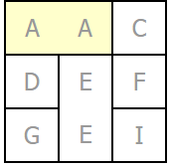
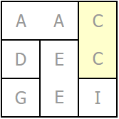
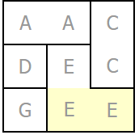
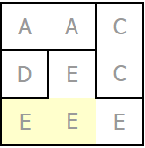
Continue…
After a few more passes of the algorithm.

Slide 11
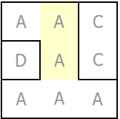
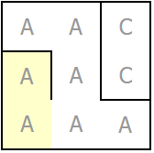
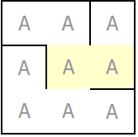
Continue…
The two trees, A and E, were joined into one set, A, implying that any cell in A is reachable from any other cell in A.
The algorithm finishes when there is only a single set left. And the result is a perfect maze!

Slide 12
Implementation
Assigning a set identifier to each cell requires iteration on every merge.
Using trees to represent the sets is much faster, allowing you to merge sets efficiently simply by adding one tree as a subtree of the other.
_sets = new ArrayList<List<Tree>>();
for ( int y=0; y < _h; ++y ) {
List<Tree> tmp = new ArrayList<Tree>();
for ( int x=0; x < _w; ++x ) {
tmp.add(new Tree());
}
_sets.add(tmp);
}

Slide 13
Continue…
Then, build the list of edges. Here I’m representing each edge as one of its end-points, and a direction:
_edges = new Stack<Edge>();
for ( int y=0; y < _h; ++y ) {
for (int x=0; x < _w; ++x ) {
if ( y > 0 ) { _edges.add(new Edge(x,y,Maze.N)); }
if ( x > 0 ) { _edges.add(new Edge(x,y,Maze.W)); }
}
}
Once you have the list of edges, shuffle them randomly:
shuffle(_edges);

Slide 14
Continue…
The algorithm itself, then, is simply a process of looping until the set of edges is empty:
while ( _edges.size() > 0 ) { ... }
Within the loop, we remove the next edge from the list, compute the other end point, and test their two sets:
Edge tmp = _edges.pop();
int x = tmp.getX();
int y = tmp.getY();
int direction = tmp.getDirection();
int dx = x + Maze.DX(direction), dy = y + Maze.DY(direction);
Tree set1 = (_sets.get(y)).get(x);
Tree set2 = (_sets.get(dy)).get(dx);
if ( !set1.connected(set2) ) {
set1.connect(set2);
_grid[y][x] |= direction;
_grid[dy][dx] |= Maze.OPPOSITE(direction);
}

Slide 15
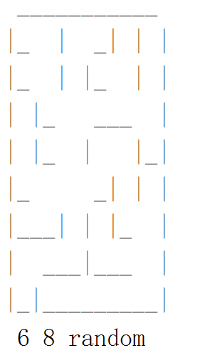
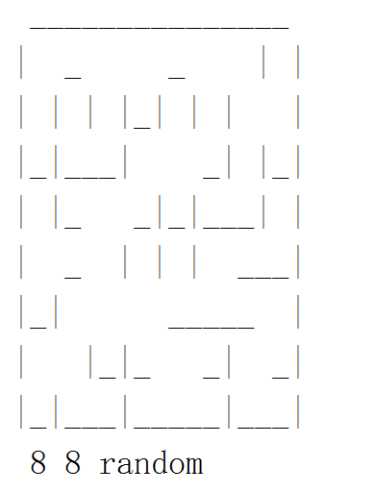
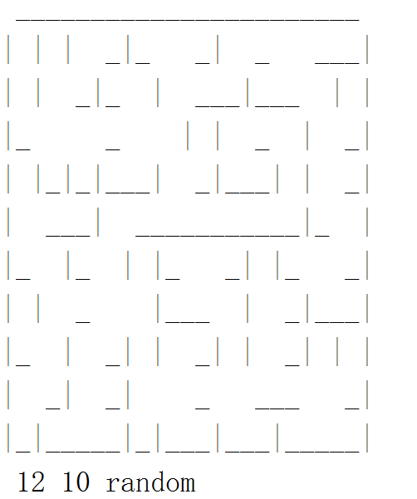
Visualization

Slide 16
Conclusion
The Kruskal's algorithm produces a minimum spanning tree. it doesn't "grow" the Maze like a tree, but rather carves passage segments all over the Maze at random, but yet still results in a perfect Maze in the end. It requires storage proportional to the size of the Maze, along with the ability to enumerate each edge or wall between cells in the Maze in random order.

Slide 17
Reference
http://www.jamisbuck.org/presentations/rubyconf2011/index.html
http://www.astrolog.org/labyrnth/algrithm.htm
http://weblog.jamisbuck.org/2011/1/3/maze-generation-kruskal-s-algorithm
https://github.com/psholtz/Puzzles/tree/master/mazes/maze-04/java

Slide 18


